Slide 2
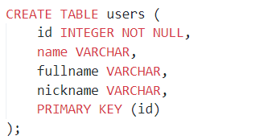
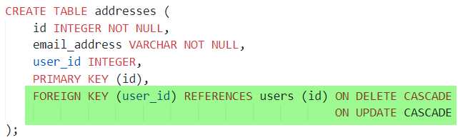
users
id | name | fullname | nickname
1 | admin | admin | adm
2 | Stone | Stone Wong | stone
addresses
id | email_address | user_id
1 | adm@smarter.com | 1
2 | stone@smarter.com | 2
3 | stone-admin@smarter.com | 2

Slide 3
